Slide 1
Muggie Maggie
Book by Beverly Cleary
Book celebration by Adi Gaircia

Slide 2
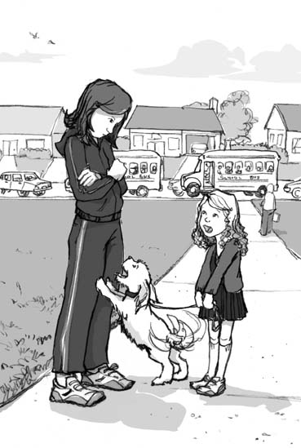
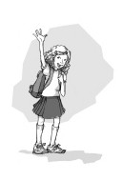
Characters
Maggie
Mom and dad
Kisser, Mrs. Leeper

Slide 3
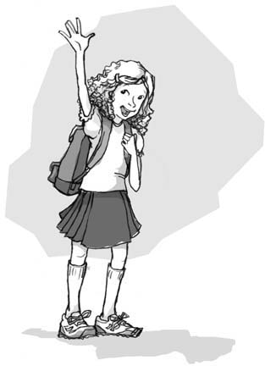
Setting
School and house
summer

Slide 4
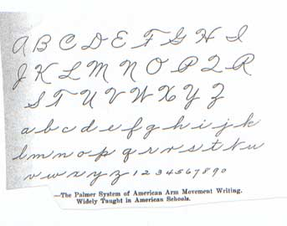
Plot Beginning
Its Maggie first day of third grade. She tride to rite cursive but she cud not do it so she said she will not learn cursive. But she does practis at home .

Slide 5
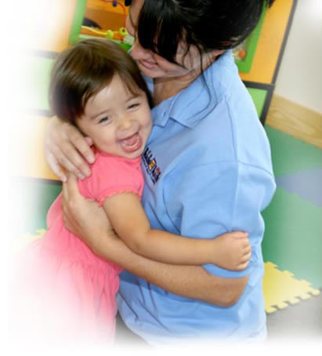
Plot Middle
She couldn’t read cursive. Also, she could not write cursive. And when she learn the teacher noticed that she read cursive and could rite cursive the teacher was so happy that she gave Maggie a big hug.

Slide 6
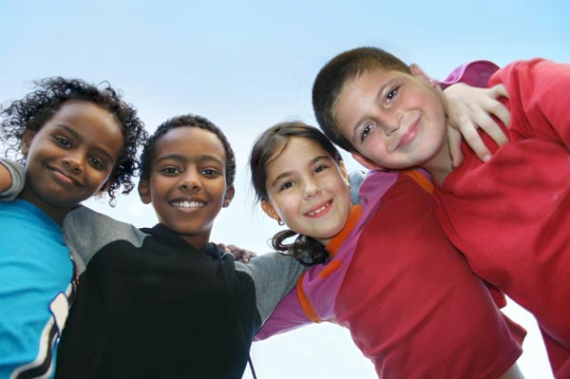
Plot End
Maggie learned how to write and read cursive. And the fourth grade boys did not tease her any more.

Slide 7
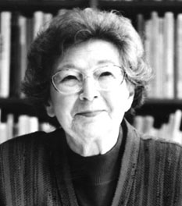
Author’s Message
Cursive may be fun but hard .

Slide 8
Favorite quote from the book
My favorite quote from the book
Wen she was writing her name in cursive but it looks like Muggie

