Slide 1
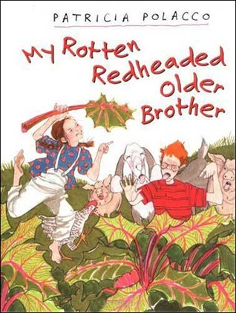
MY Rotten Redheaded older Brother by Patricia polacco
Book Celebration by AJ SCHOFIELD

Slide 2
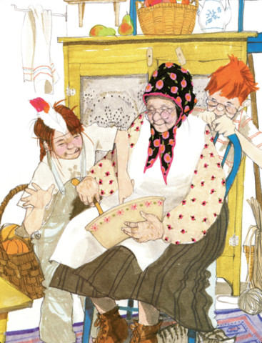
Characters
Patricia Polacco
.grandmother
.Richard
.mother
.grandparents

Slide 3
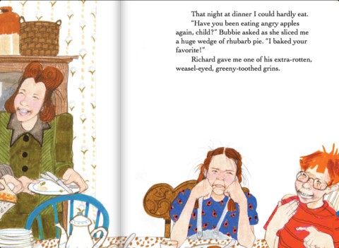
Setting
House
Spring
outside

Slide 4
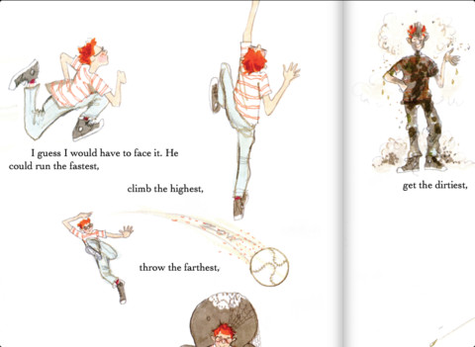
Plot Beginning
In the beginning they where in the house
making chocolate cake. She can tell stores.

Slide 5
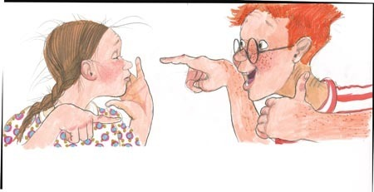
Plot Middle
Richard can run the fastest climb the highest. Throw the farthest. sit the longest. get the dirtiest burp the loudest spit the farthest.
.

Slide 6
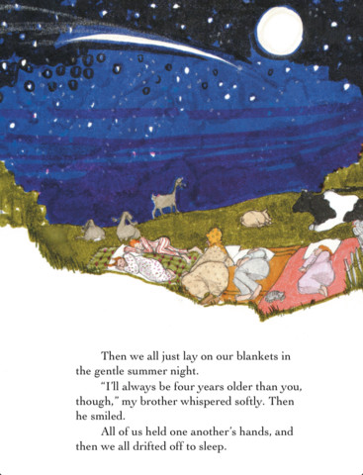
Plot End
They all sleep outside and lay down with a cow.

Slide 7
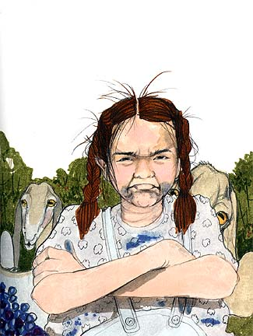
Author’s Message
Bullies are not good.

Slide 8
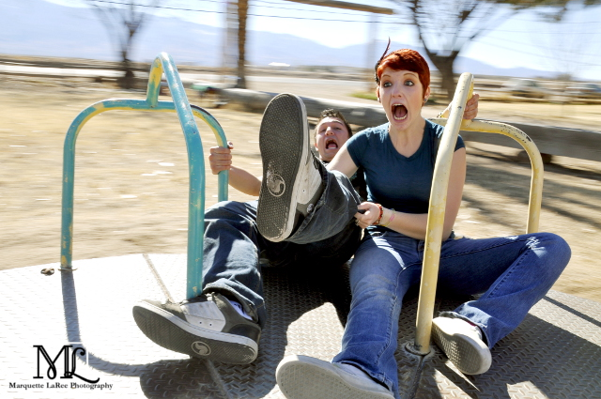
Favorite quote from the book
When Trisha falls off the merry go round

