Slide 1
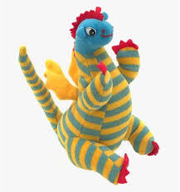
My Fathers Dragon by Ruth Stiles Gannett
Book Celebration By Aremi Calderon ☺

Slide 2
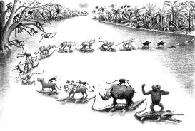
Characters
Elmer (man)
Dragon ☺
Animals (cat, loin, tigers, baby monkeys and two hogs)☺

Slide 3
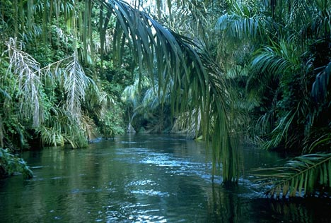
Setting
It is in the Jungle.
and it is in the summer .
And I think it takes place in 1986 because it is black and white.

Slide 4
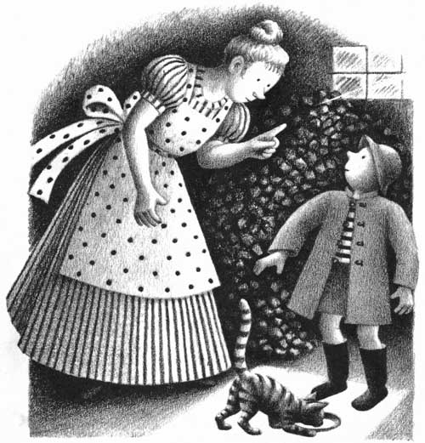
Plot Beginning
Elmer meets a cat and gives the cat food and milk every single day and Elmer takes care of the cat and gives it shelter. But his mom did not let him.

Slide 5
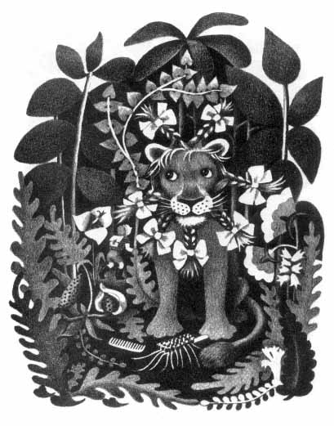
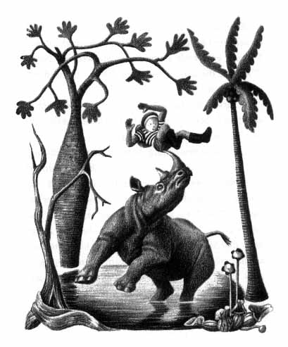
Plot Middle
Elmer is going to save his dragon on his way he meets all these crazy animals that talk .

Slide 6
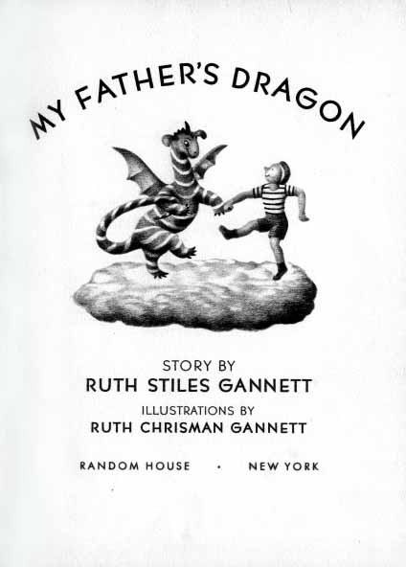
Plot End
When Elmer finished with all the animals he found his dragon and they both went home together and where very happy .☺ ☺ ☺ ☺

Slide 7
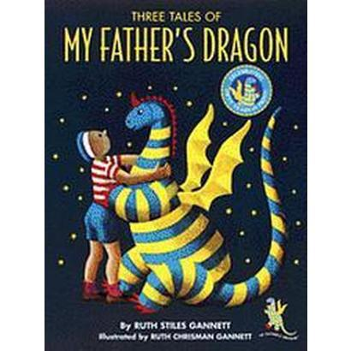
Author’s Message
Never loose your best friend. ☺

Slide 8
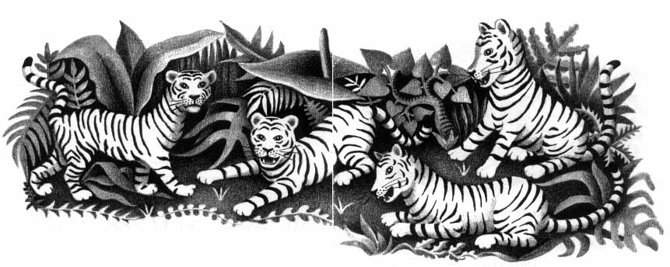
Favorite quote from the book
It is when Elmer makes believe that gum can grow into a gum tree to the tigers so they wont eat him it.
Page 43. ☺☺☺

