Slide 1
Michael Vey :the prisoner of cell 25 Author: Richard Paul Evans
Book celebration by Cannon Twomey

Slide 2
Characters
Michael Vey
Ostin
Taylor
Hatch

Slide 3
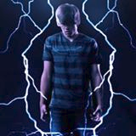
Setting
In the suburbs of Idaho
Elgen academy.
Spring time.

Slide 4
This is the summary
Michael Vey said, ‘’This story I’m about to tell you is weird, full of fear , and full of adventure .This is my story’’.

Slide 5
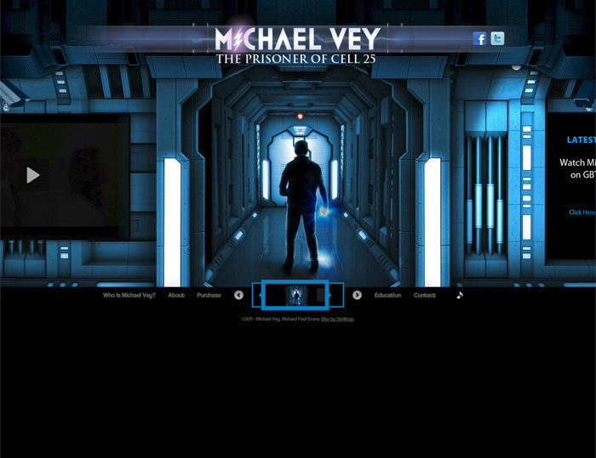
BOOK 1
In the beginning Michael Vey was not aloud to use his powers, so everyone thought he was a dork. So people would trip, spit on, and make fun of him. Then one day he used his powers on someone because they were trying to pants him. Then a cheerleader, Taylor, saw him.

Slide 6
BOOK 2
Taylor has powers too, and Michael Vey found that out later on. Then Ostin, Taylor, and Michael Vay went to look for his mother

Slide 7
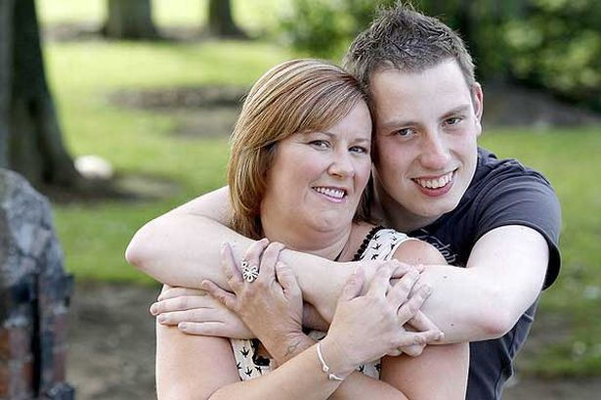
End
They found were the elgen were hiding his mother. Will they get his mother the world may never know

Slide 8
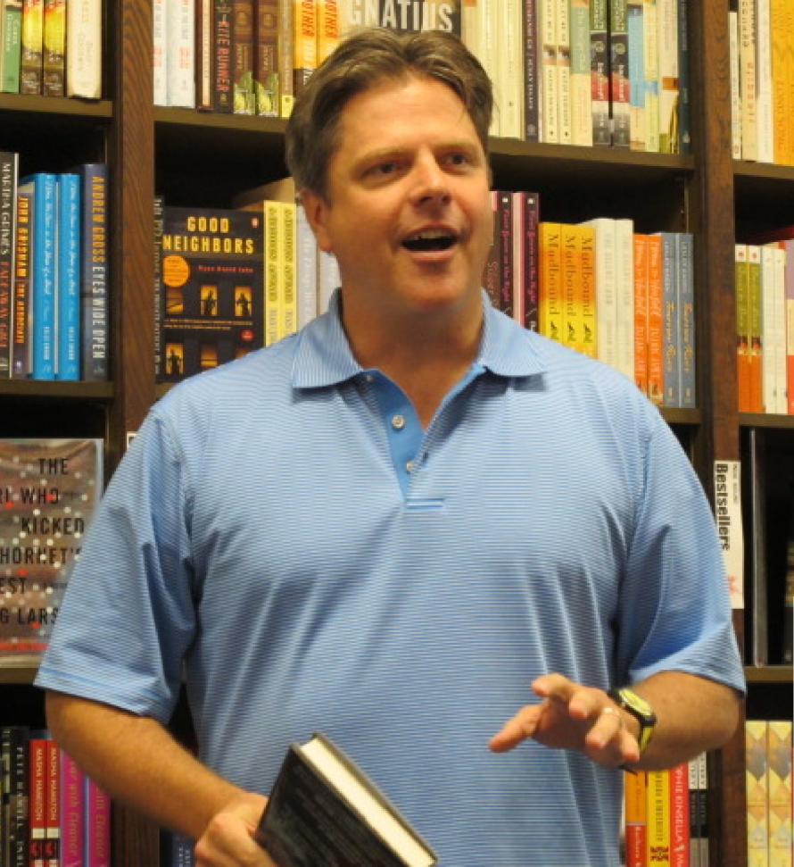
Author’s Message
Triumph over evil!

Slide 9
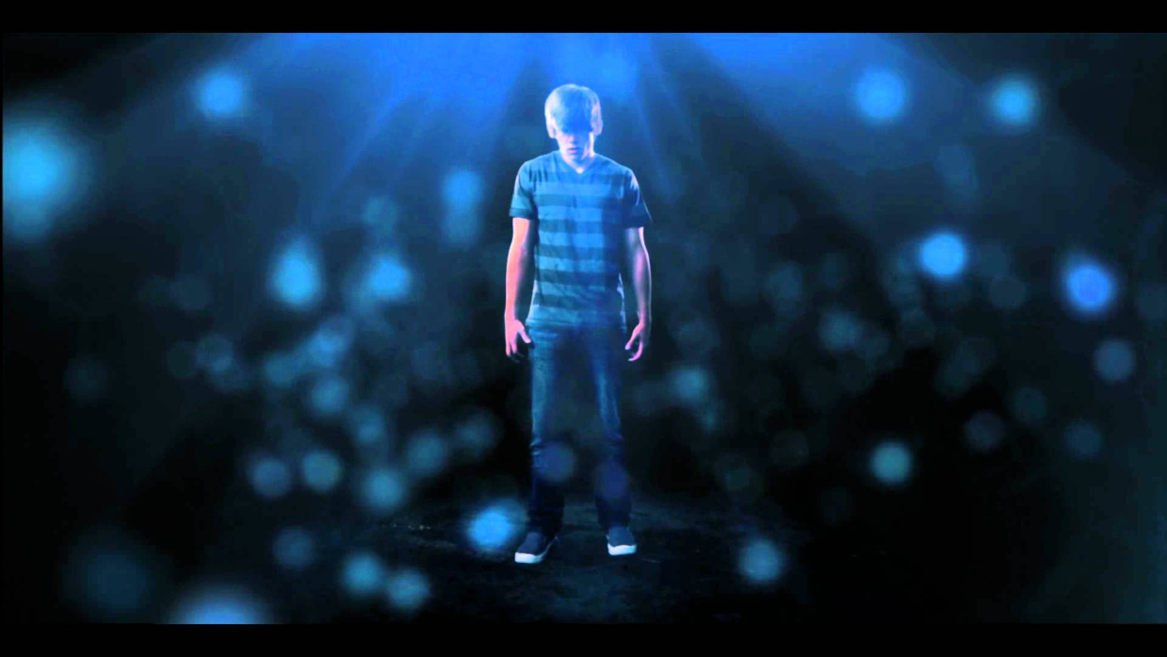
Favorite quote from the book
“I love when I can reboot people when they are being mean to others...”

