Slide 1
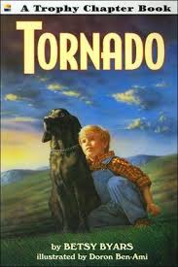
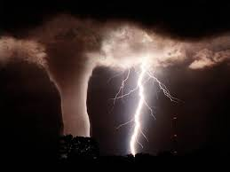
Tornado Author: Betsy Byars
Book Celebration
By Connor Liam Donaldson

Slide 2
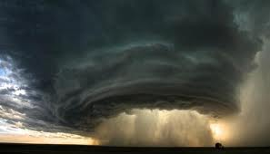
Characters
Pete
Tornado the dog
His parents
Beth

Slide 3
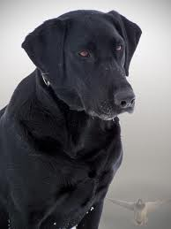
Setting
In a storm seller during a tornado
A farm house

Slide 4
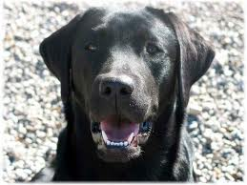
Plot Beginning
In the beginning there is a family stuck in a tornado
They find a dog and they named him Tornado

Slide 5
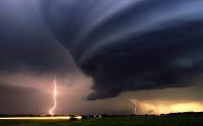
Plot Middle
They keep the dog
Tornado causes trouble

Slide 6
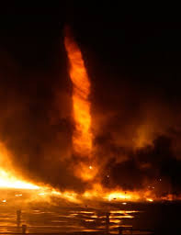
Plot End
In the end they go to the store and they left the dog in the trunk .
The owner found the dog .
They got in an argument the owner kept the dog
When he got home he cried for along time
In the farm he heard a noise. It was tornado!

Slide 7
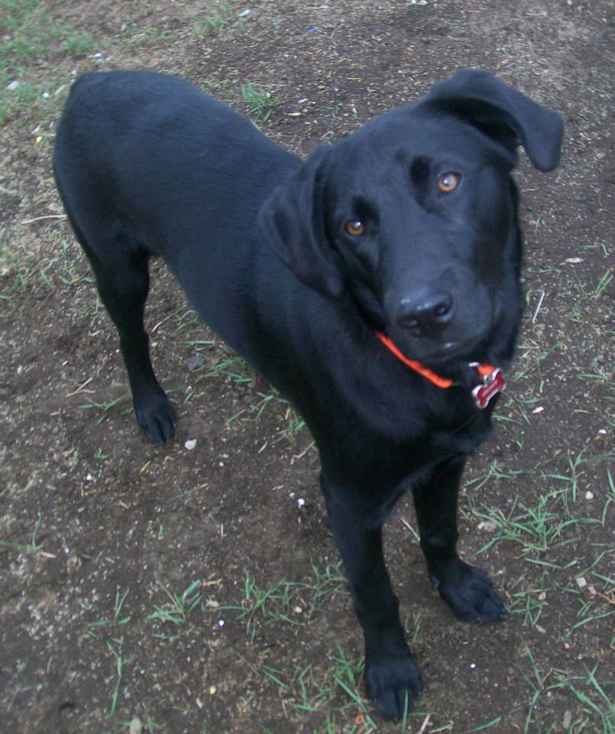
Author’s Message
You can keep anything as long as you know you are it’s owner.

Slide 8
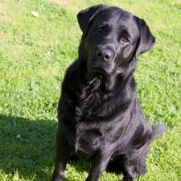
Favorite quote from the book
Tornado is back!
It is on page 47

