Slide 1
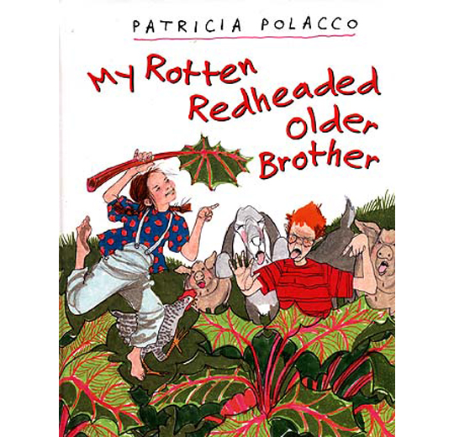
My Rotten Redheaded Older Brother by Patricia POLACCO
Book Celebration
By Daisy Garcia

Slide 2
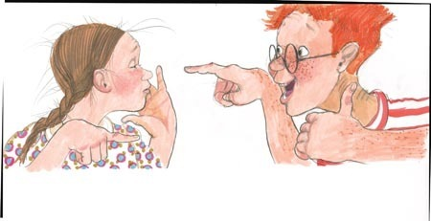
Characters
Patricia
Grandma
Richard

Slide 3
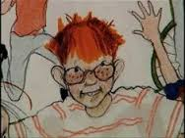
Setting
Farm
Summer

Slide 4
Beginning plot
At the beginning the brother thought he was better then his sister

Slide 5
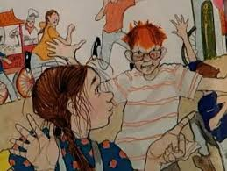
Plot Middle
Then go the merry-go-round and the sister beats him at the merry-go-round

Slide 6
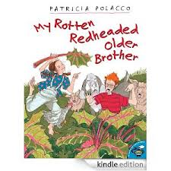
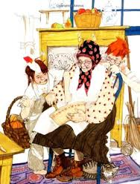
Plot End
They get to together and have fun.

Slide 7
Author’s Message
It is fun to get together with family.

Slide 8
Favorite quote from the book
When the sister beats her brother at the merry-go-round - on page 15

