Slide 1
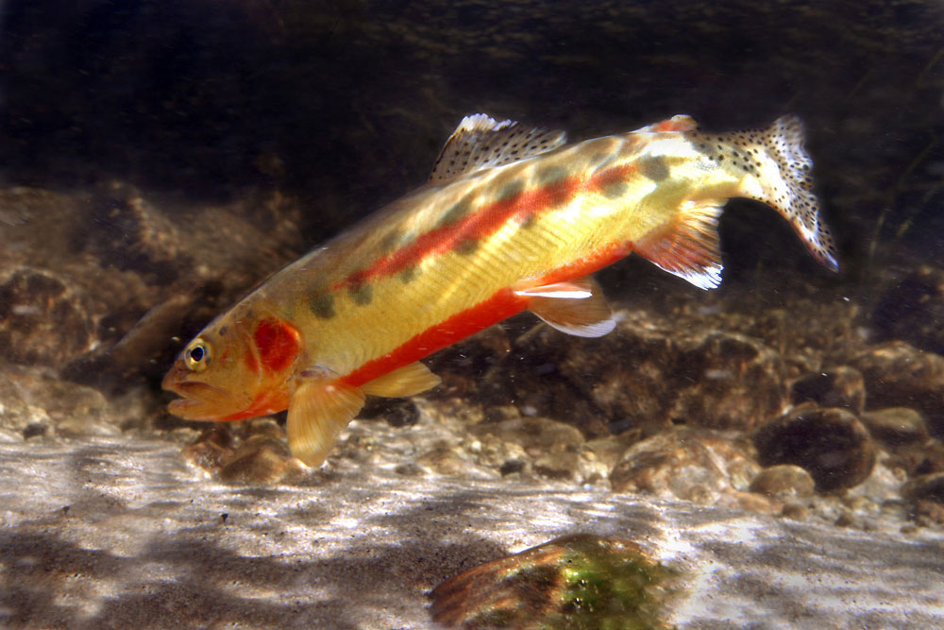
TROUT, TROUT, TROUT
Author: April Pulley Sayre
By Daniel

Slide 2
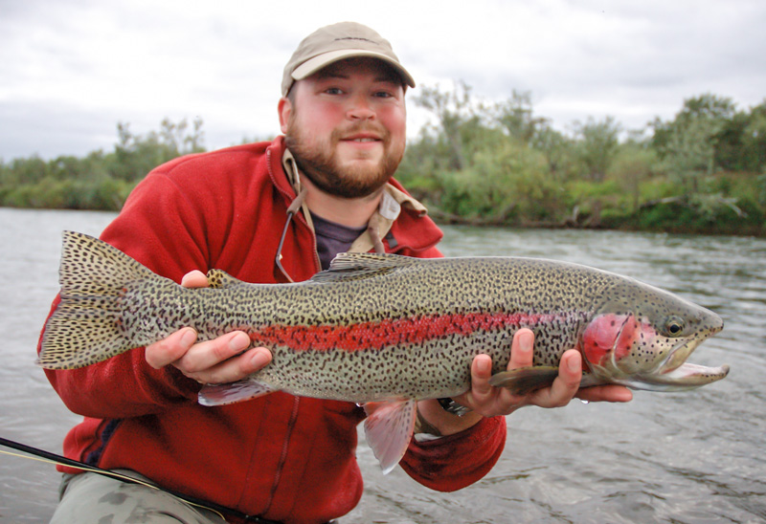
Characters
Eel
Bass
Starhead Topminnow

Slide 3
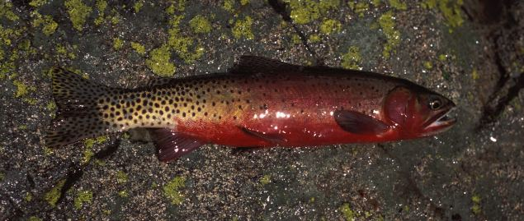
Setting
Ti tack in lake

Slide 4
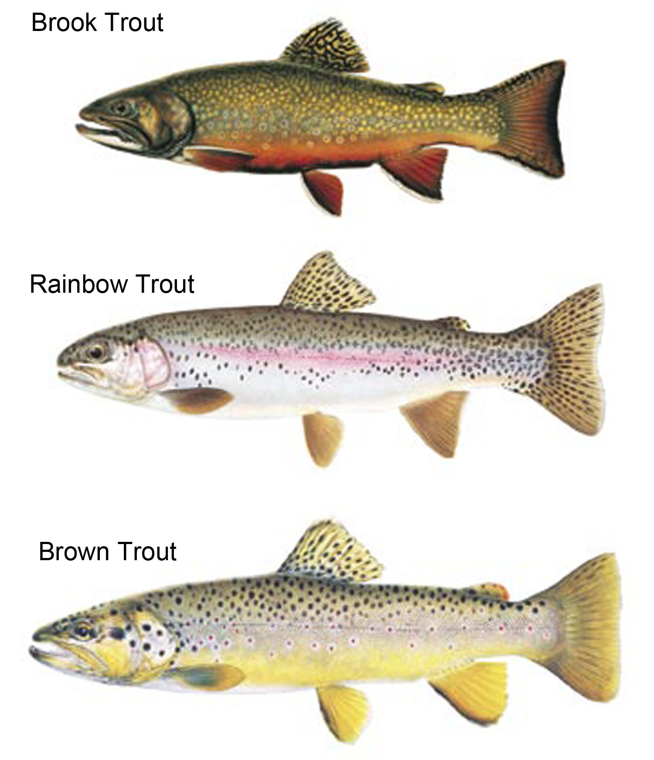
Plot Beginning
Fish is going to school

Slide 5
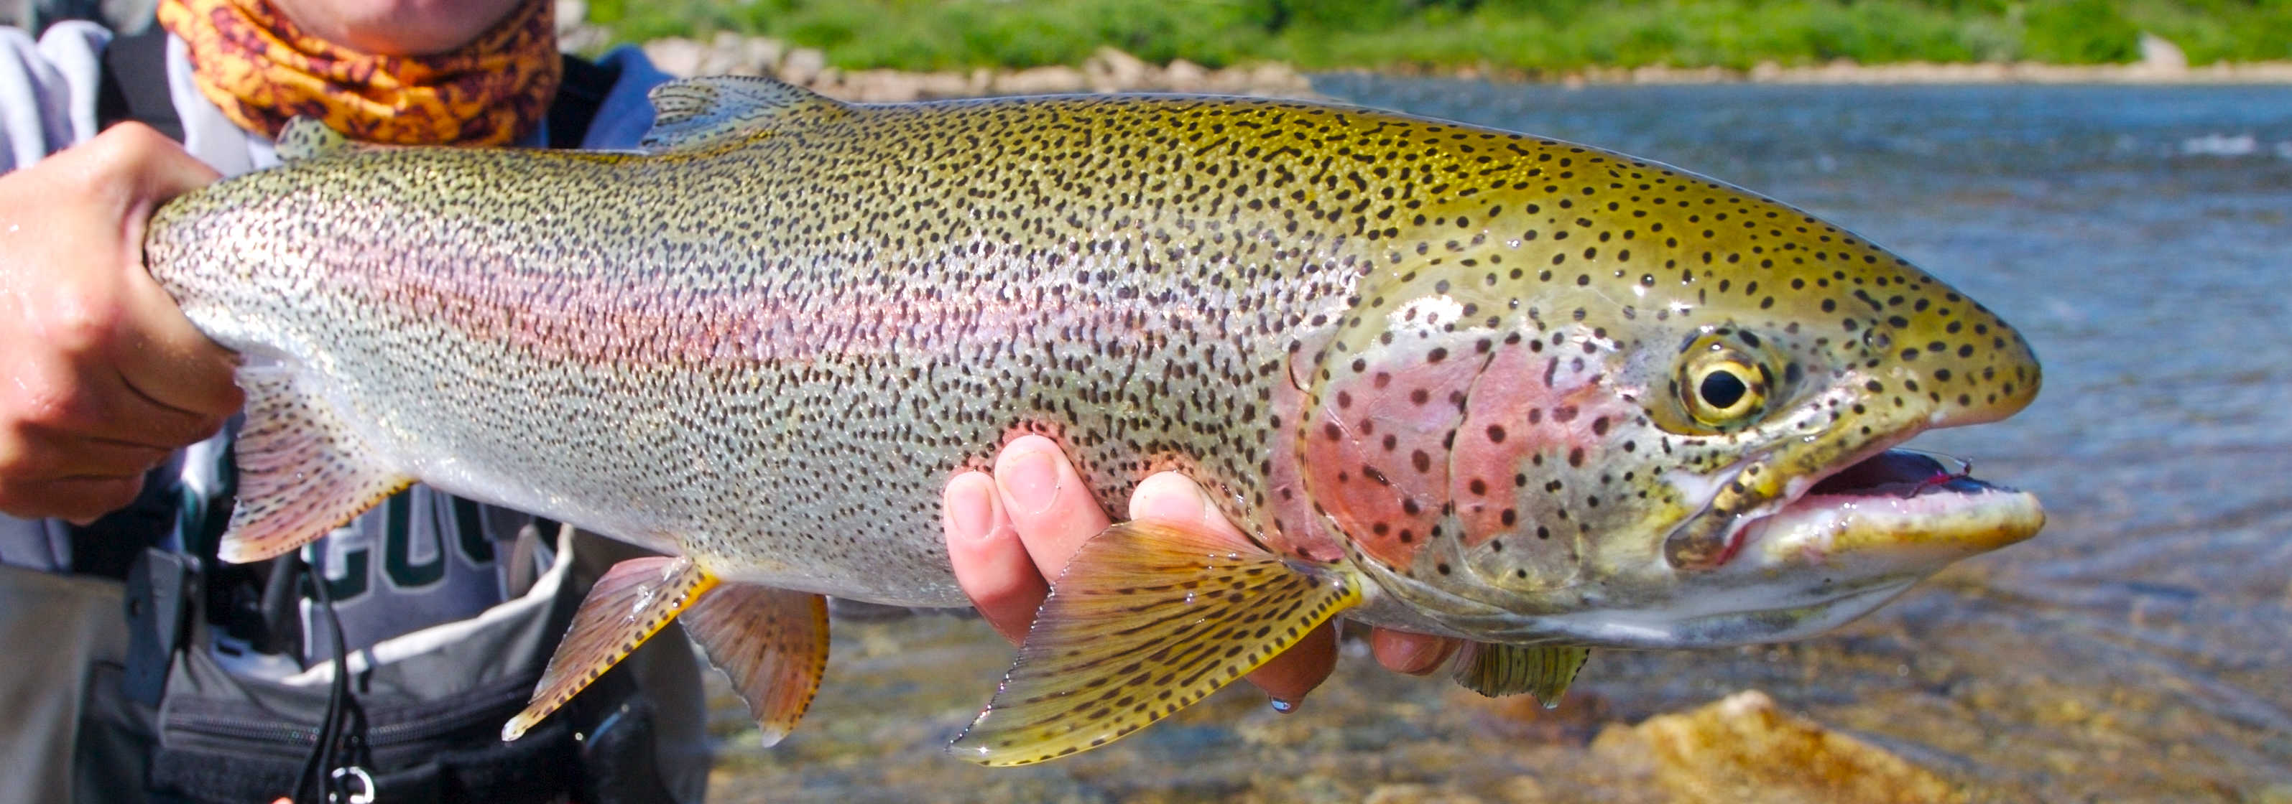
Plot Middle
Tons of worms hanging above a fish

Slide 6
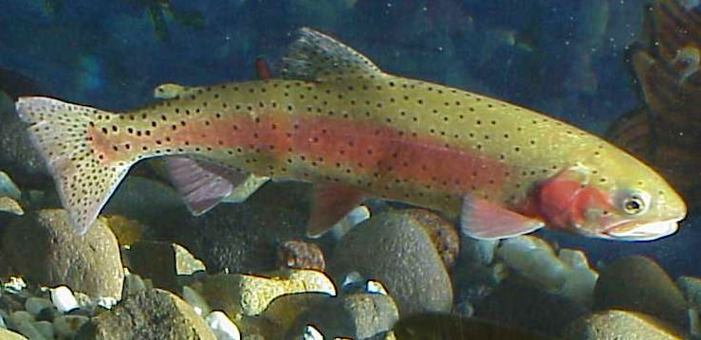
Plot End
Kid putting his feet in water.

Slide 7
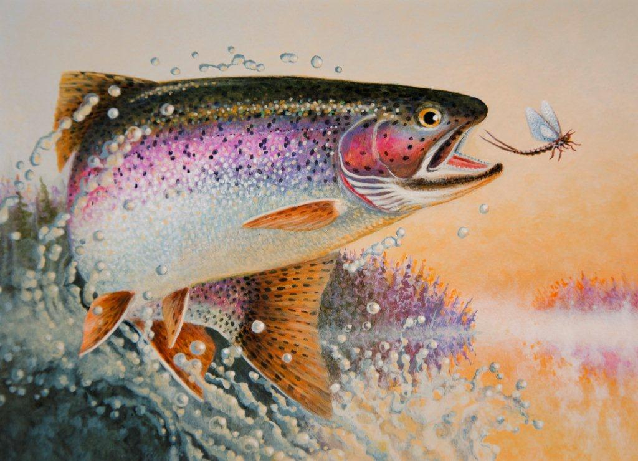
Author’s Message
To make people read.

Slide 8
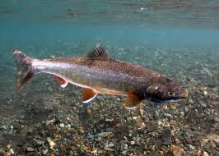
Favorite quote from the book
They are fun
It is fun to read the book.

