Slide 1
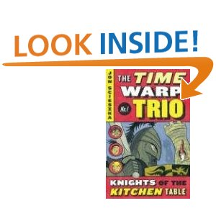
The Time warp Trio Knights of the Kitchen Table author Jon Scieszka
Book Celebration
By Daxton Larsen

Slide 2
Characters
Joe, Sam, and Fred
Knights of the table
King arther , the Queen, and Merlin

Slide 3
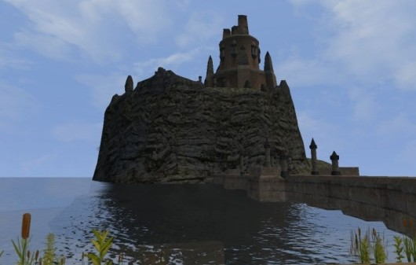
Setting
Camelot
20th- century

Slide 4
Plot Beginning
They are at a house doing birthday stuff and having fun but there is a other present. It was from his uncle Joe or Joe the magnificent! Yahoo! Said Joe. Then Joe teared the wrapping paper and it was a book with a very dark blue, gold stars, and moons with twisting silver desings.

Slide 5
Plot Middle
They went to Camelot and saw a black Knight which was bad and was going to kill them but one had a idea to make him fall down on the ground. After they did that they saw three knights but good ones not bad ones and they came with them to the castle.

Slide 6
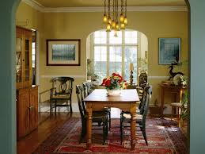
Plot End
They are back in the house and Joe still had the Queens card in his pocket and has been standing in the room. And having no fun.

Slide 7
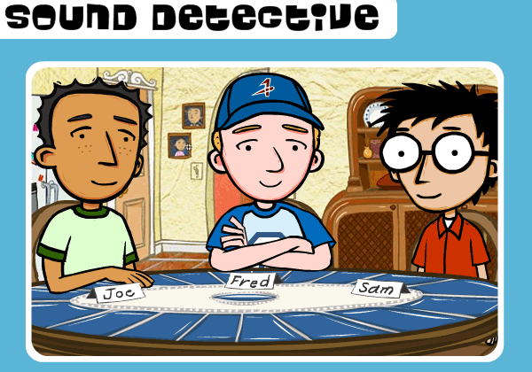
Author’s Message
That you can have adventures with friends and families.

Slide 8
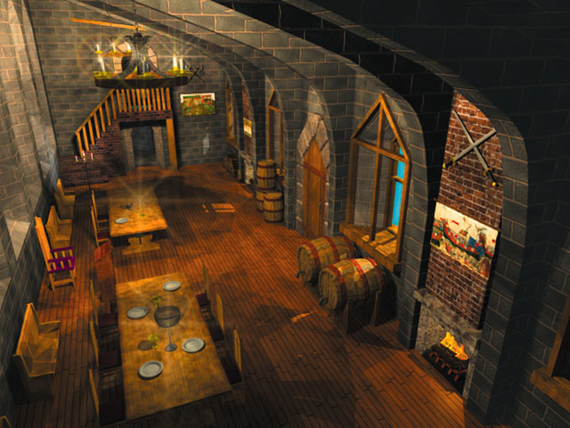
Favorite quote from the book
“Fred, Sam, and I stood in the middle of the Great hall of Camelot”.
pg24

