Slide 1
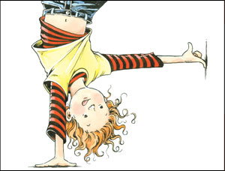
Clemintine
Author Sara PennyPacker by Emma

Slide 2
Setting
The setting is the apartment,and school.
I think it was Fall in the story.

Slide 3
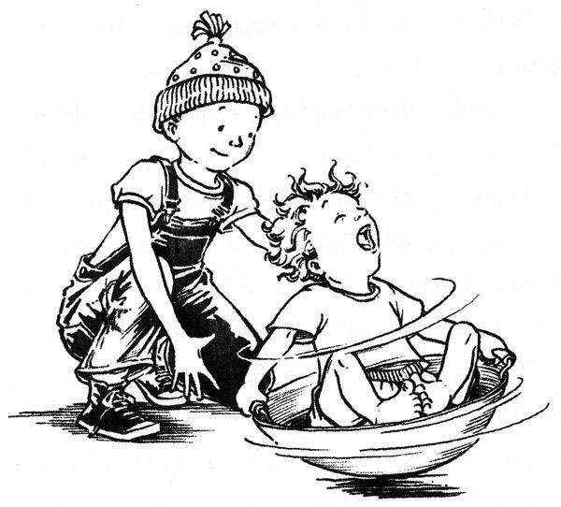
Plot Beginning
In the beginning Clementine cut off Margets hair because Marget got glue in her hair!

Slide 4
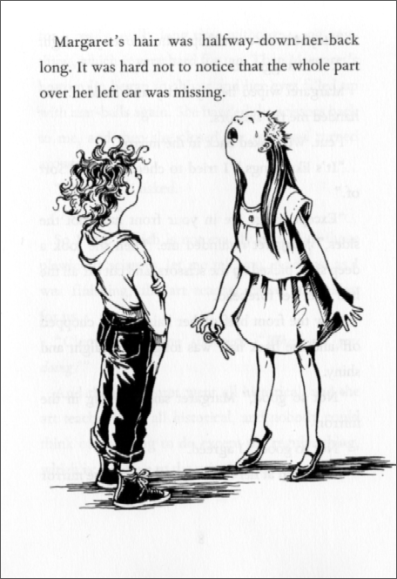
Plot Middle
In the middle Clemintine cut off her own hair.

Slide 5
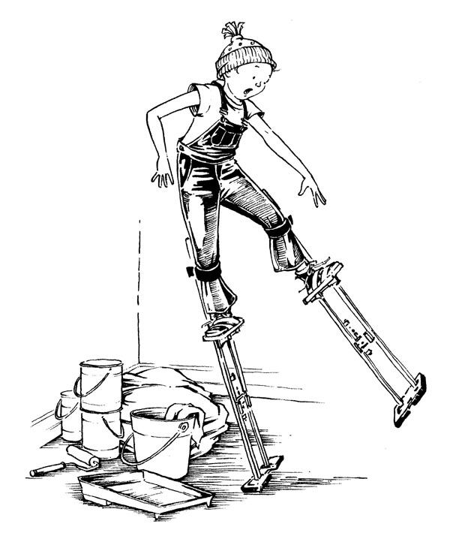
Plot End
In the end they had a party.

Slide 6
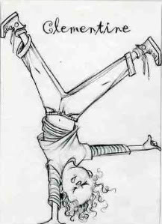
Author’s Message
I think the Authors message was to be a friend.

Slide 7
Favorite quote from the book
My favorite part is when she asked for a video and gummy worms.
The page number is 95

