Slide 1
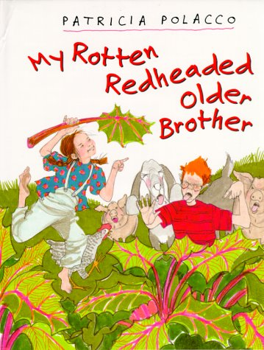
My Rotten Redheaded Older Brother Author Patricia Polacco
Book Celebration
By Estefani Guadarrama

Slide 2
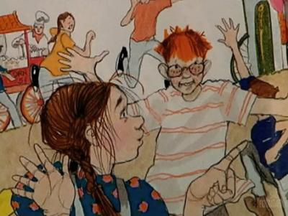
Characters
Patricia, Richard, grandma and mom.

Slide 3
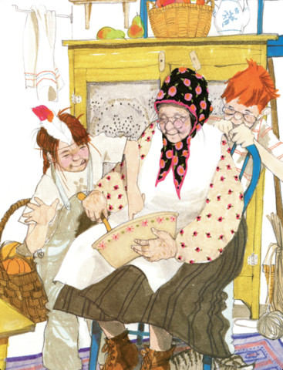
Setting
Farm Union City, Michigan.

Slide 4
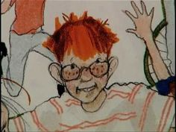
Plot Beginning
She couldn’t quite understand how she could even like my older brother, Richard I can’t stand you Richard!’’

Slide 5
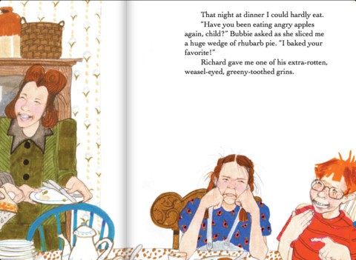
Plot Middle
she was so mad ,that she couldn’t even feel her belly was starting to ache.

Slide 6
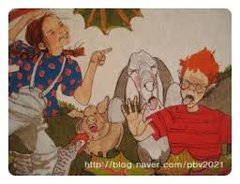
Plot End
Then they all just laid on our blankets in the gentle summer night. I’ll always be four years older than you Richards.

Slide 7
Author’s Message
Two never fight with your older sibling.

Slide 8
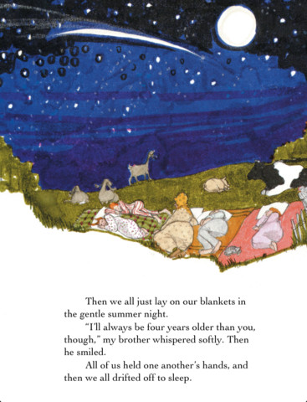
Favorite quote from the book
When he tricks his sister about when he doesn’t like the puckers.

