Slide 1
The Boxcar Children Gertrude Chandler Warner
Book Celebration
By Gabrielle Hollingsworth

Slide 2
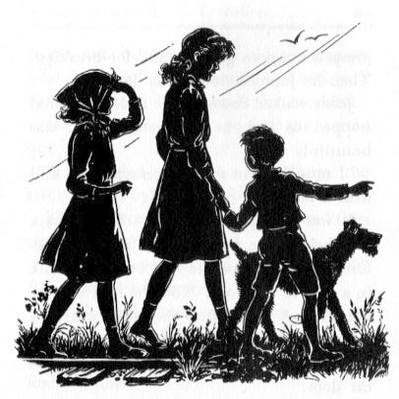
Characters
Henry
Jessie
Violet
Benny
Dr. Moore

Slide 3
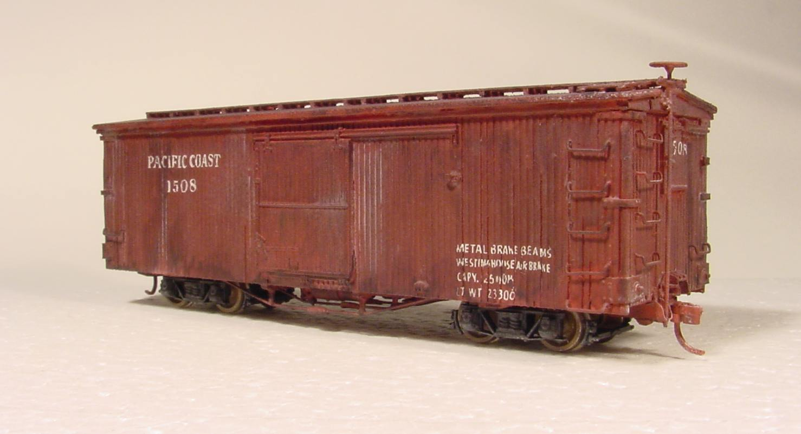
Setting
- Boxcar
Fall
Forest

Slide 4
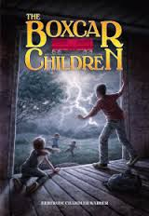
Plot Beginning
At the beginning the kids saw a bakery. They ran to the woods because the bakery wanted to send Benny to a children’s home. Just as they got there a horse was coming up the road. Keep very still, Benny wisped Henry.

Slide 5
Plot Beginning
At the beginning the kids saw a bakery. They ran to the woods because the bakery wanted to send Benny to a children’s home. Just as they got there a horse was coming up the road. Keep very still, Benny wisped Henry.

Slide 6
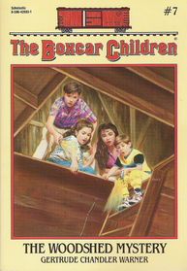
Plot Middle
The children finned a boxcar and ran there. And they use the boxcar as a house Henry ran to a town to find a job. They fond a dog named watch.

Slide 7
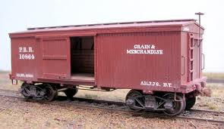
Plot End
They found there Grandpa in the boxcar.

Slide 8
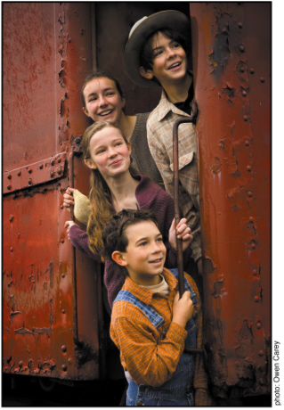
Author’s Message
Lost family can come together.

Slide 9
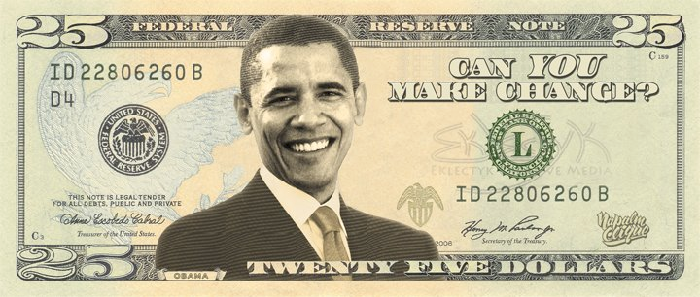
Favorite quote from the book
My quote is Henry gets 25$ and Benny says “Is 25$ a lot.” “No” says Henry.

