Slide 1
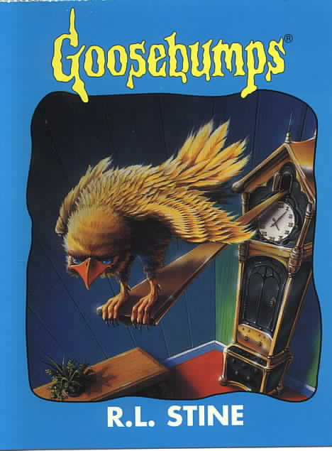
Goosebumps
Book celebration by
By R.L. Stine

Slide 2
Characters
Michael.
Sister, mom, dad, friends.

Slide 3
Setting
House.
Summer.

Slide 4
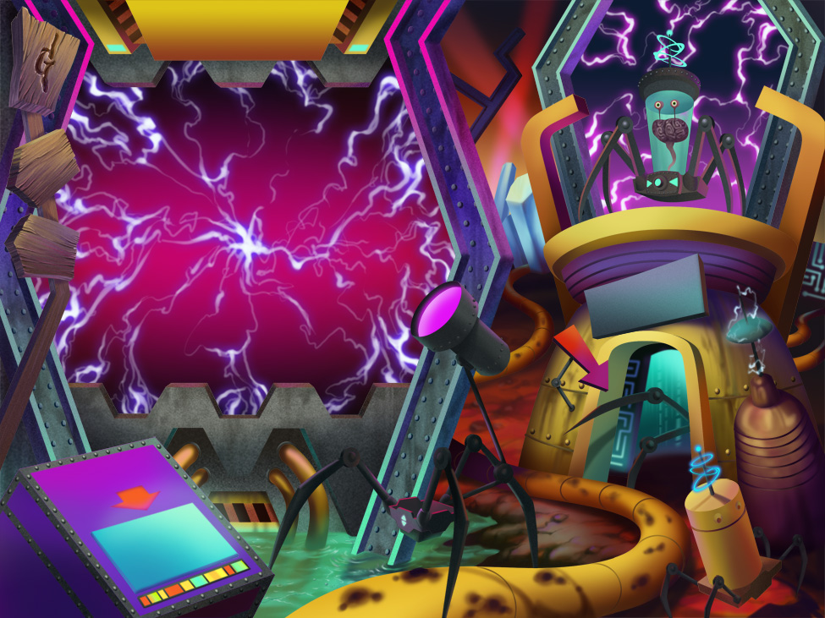
Plot Beginning
The oldest brother Michael was having a birthday party. Then his sister trips him over with a cake. So his face land on the cake.

Slide 5
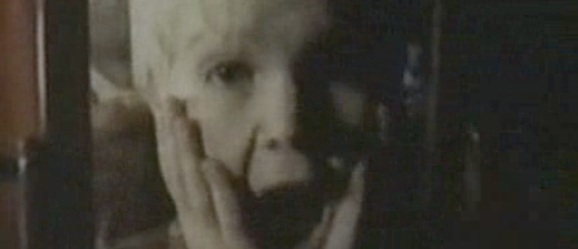
Plot Middle
So his friends tease him. But he did not like it. So he went to his room.

Slide 6
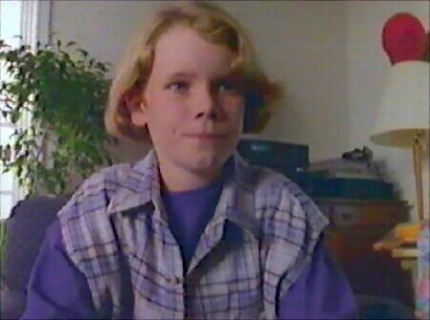
Plot End
Michael hit the clock of doom so he went to the pass.

Slide 7
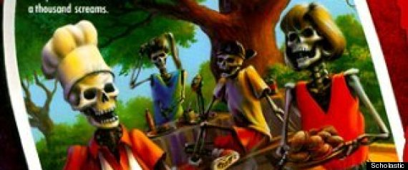
Author’s Message
The author’s message is that we do not hit yours dad’s clock.

Slide 8
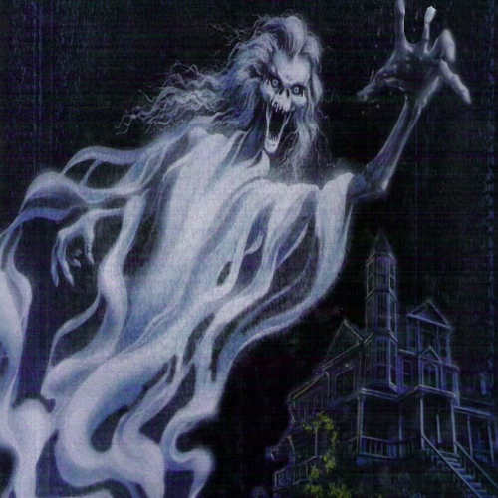
Favorite quote from the book
“My favorite quote from the book is on page 118
,and it says,” that his sister was gone for good.

