Slide 1
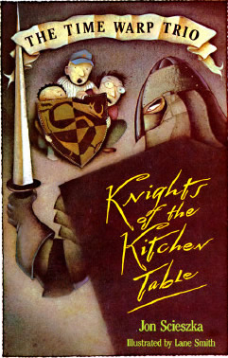
The Time Warp Trio Knights of the Kitchen Table Author: Jon Scieszka
Book Celebration
By Geovani

Slide 2
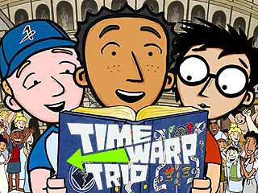
Characters
Joe, Sam, and Fred

Slide 3
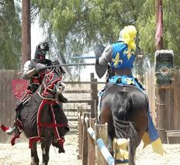
Setting
Brooklyn, New York
Medieval Times, Camelot

Slide 4
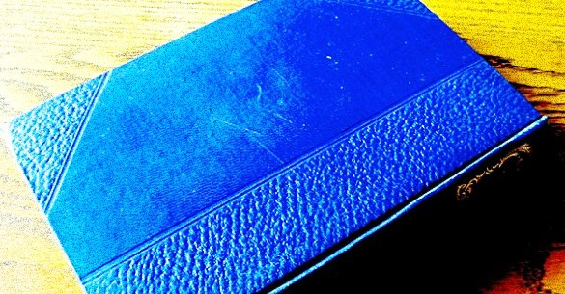
Plot (beginning)
For his tenth birthday, Joe receives a mysterious blue book from his magician uncle.

Slide 5
Plot (middle)
The Book transports Joe and his friends, to different times and places

Slide 6
Plot (end)
The only way they are able to return to present-day is to find The Book again in the time period they are in.

Slide 7
Author’s message
They overcome lots of challenges.

Slide 8
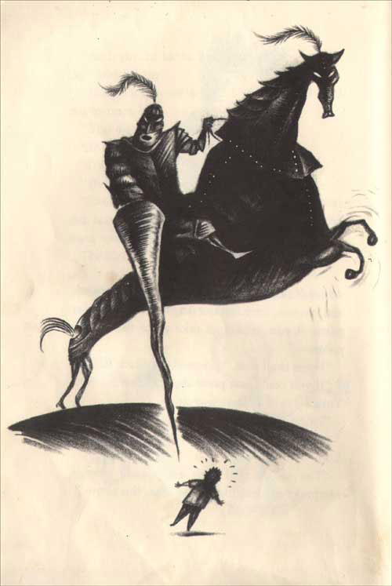
Favorite Quote

