Slide 1
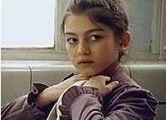
Molly’s pilgrim Barbara Cohen
Book Celebration
By Hailey Larsen

Slide 2
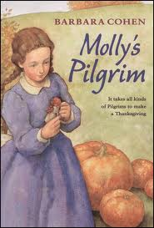
Characters
molly
mama
Miss Stickley

Slide 3
Setting
school
fall

Slide 4
Plot Beginning
First Molly’s Classmates laughed a her.

Slide 5
Plot Middle
Next Molly walks in and the teacher said “open your book’s to page 132.”

Slide 6
Plot End
Last, Her classmate said “that’s the most beautiful doll”.

Slide 7
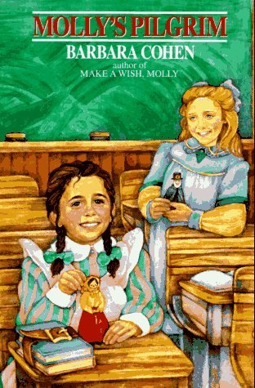
Author’s Message
Never judge someone by there appearance.

Slide 8
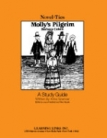
Favorite quote from the book
It takes all kinds of pilgrims to make a thanksgiving.
Page 32

