Slide 1
The Boxcar Children Gertrude Chandler Warner
Book celebration
Hallie

Slide 2
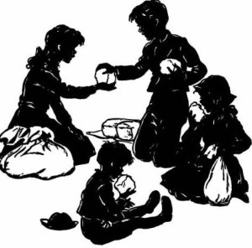
Characters
Henry
Jessie
Violet
Benny
Dr.Moore

Slide 3
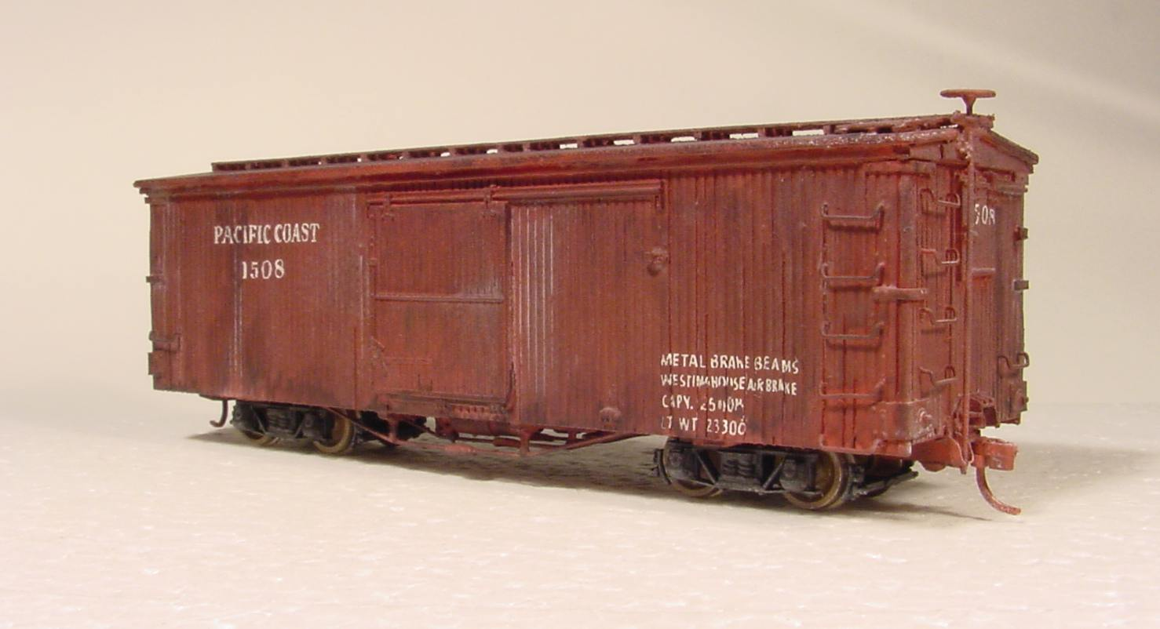
Setting
boxcar
forest
Fall

Slide 4
Plot Beginning
At the beginning the kids find a bakery. They stay at the bakery in till the morning. They run away because the baker’s wife was going to take Benny to the children’s home. So Violet tells Benny that he can pretend to be a little brown bear to make him walk.

Slide 5
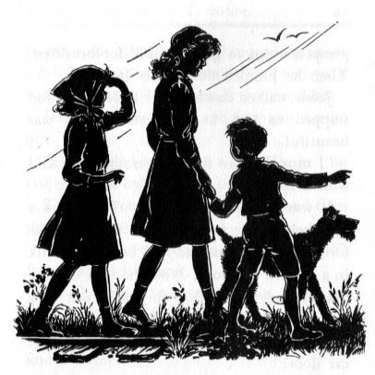
Plot Middle
The children find a boxcar that they use as a house. Henry finds a job for Dr.Moore. He mows his lawn and picks the cherries of the tree. While Henry was gone the other kids found a dog and named it Watch.

Slide 6
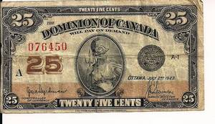
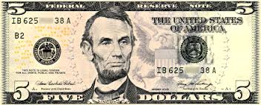
Plot End
Henry does a free for all and wins 25$. Then Henry buys some bread and milk and still has 5$. Benny thinks that a lot but Henry says it’s not. The kids find there grandpa and they live with him.

Slide 7
Author’s Message
Family should stay together.

Slide 8
Favorite quote from the book
“The cake is good Jessie “The little boy said. Page 8

