Slide 1
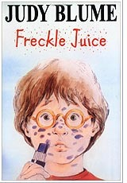
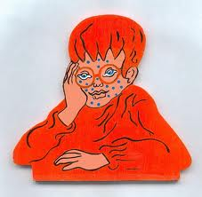
Freckle Juice Judy Blume
Book Celebration
By Jasmine Medina

Slide 2
Characters
Andrew, Nicky, Miss. Kelly, Sharon

Slide 3
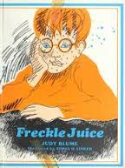
Plot End
Sharon tells Nicky I know how to get rid of them and Nicky says rid of what the freckles .

Slide 4
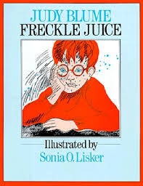
Plot Beginning
It’s about a kid named Andrew he wants freckles he has to figure out to get freckles.

Slide 5
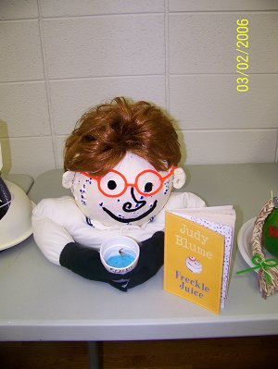
Author’s Message
Is that you should be proud of your self.

Slide 6
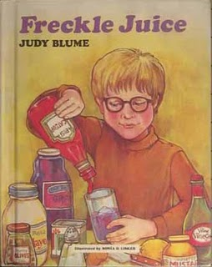
Plot Middle
He is trading fifty cents for a recipe for freckles.

Slide 7
Favorite quote from the book
When he tried the freckle juice.

Slide 8
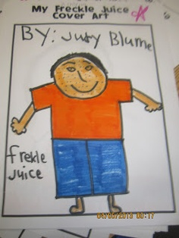
Authors massage
Be yourself!

