Slide 1
Gaby Lost And Fond author Angela Cervantes
Book Celebration
By Kaia

Slide 2
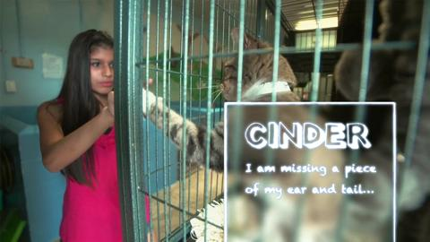
Characters
Gaby
Alma
Dr. Villalobos
Gaby’s Father

Slide 3
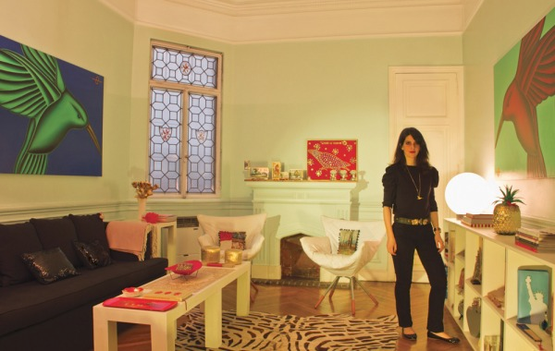
Setting
Gaby’s house ,and the shelter
Summer

Slide 4
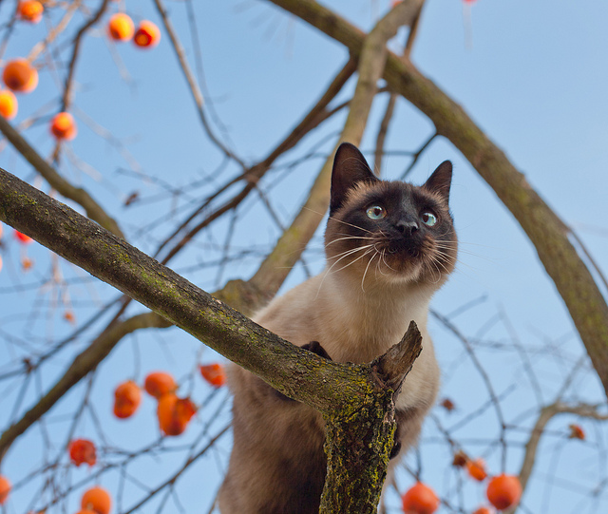
Plot Beginning
A Siamese cat crouched on a tree branch.
The cat was stuck, Gaby climbed up and grabbed the cat. Gaby decided to work at the shelter after getting lots of letters from the shelter.

Slide 5
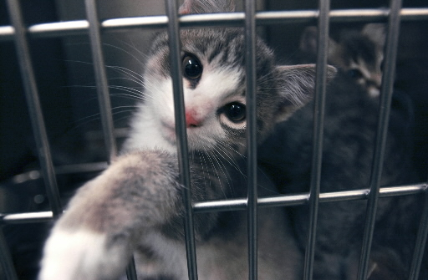
Plot Middle
Gaby’s father congratulated her a good job working at the shelter.

Slide 6
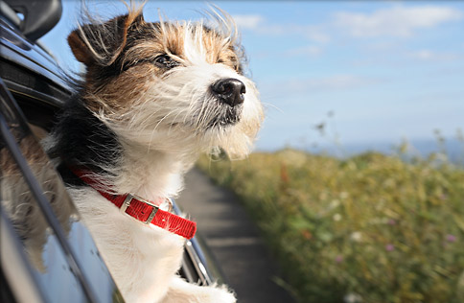
Plot End
Alma rolled down the window and asked why do dogs stick there heads out the window? See for your self! Gaby was glad to go home.

Slide 7
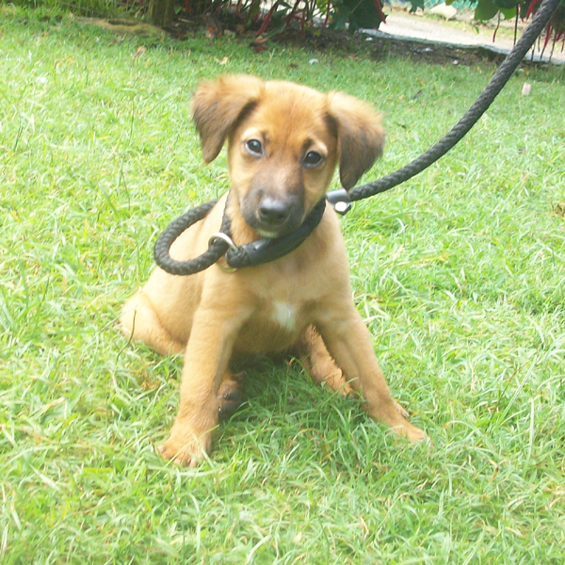
Author’s Message
Never doubt the people you love.

Slide 8
Favorite quote from the book
Gaby closed her eyes and stuck her head out into the wind. The warm breeze blew her hair back, as the sun’s rays pressed against her smiling face.
page 220

