Slide 1
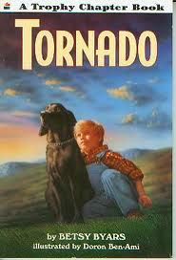
Tornado By Betsy Byers
Book Celebration
By Lilian Abrams

Slide 2
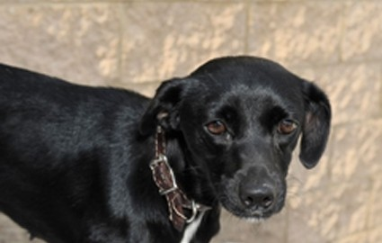
Characters
Pete
Tornado, family
farmer

Slide 3
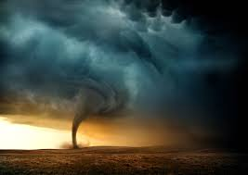
Setting
During a tornado
I think the time of year was in 1967 .

Slide 4
Plot Beginning
Pete begins to tell a story about a dog that he found after a tornado when he was a little boy.

Slide 5
Plot Middle
Tornado is a funny dog that does card tricks and saves a turtle.

Slide 6
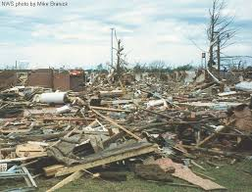
Plot End
The storm ends.

Slide 7
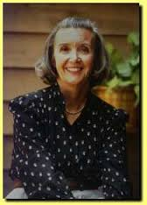
Author’s Message
There are many adventures in life.

Slide 8
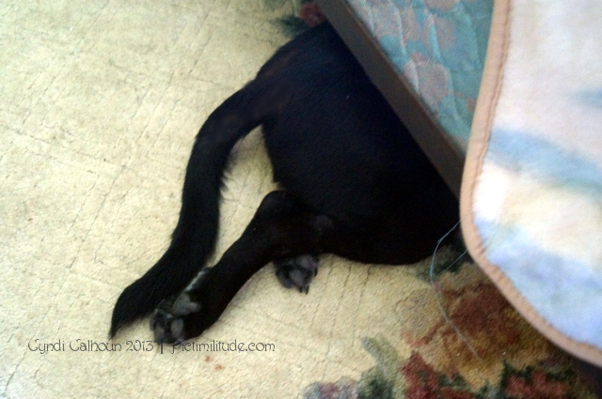
Favorite quote from the book
“Well, you can come out now,” he told the dog.
On page 11

