Slide 1
Murder Past Due Author: Miranda James
Book Celebration
By Mary Bishop

Slide 2
Characters
*Charlie who is a man
*Diesel who is a cat
*Julia who is a woman
*Godfrey Priest who is a man writer
*Ezra who is Julia’s husband
*Jason who is Julia’s son

Slide 3
Setting
Where it took place was a small town
The Time of Year was fall/spring

Slide 4
Plot Beginning
A man named Godfrey Priest, a writer, gets murdered. No one knows who killed him, but one person to think about is Ezra, a man that is married to Godfrey’s ex-wife, Julia.

Slide 5
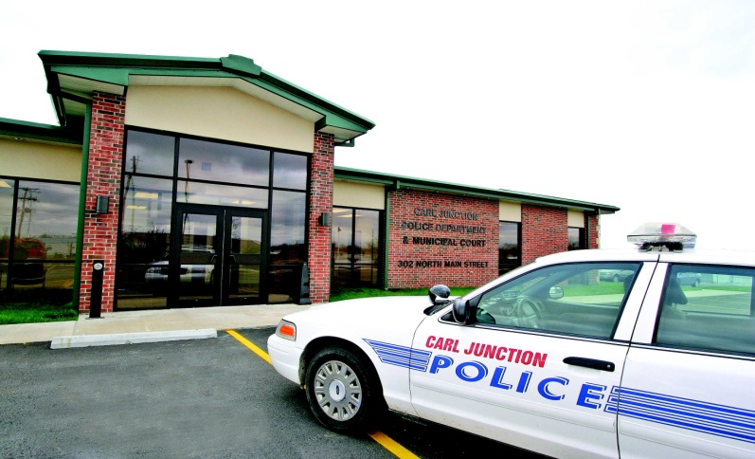
Plot Middle
Charlie and his cat, Diesel, go to the police so they could help him find out who the murderer was. Julia, Godfrey’s ex-wife, works with them to find out.

Slide 6
Plot End
It takes a long time to find out, but the police, Charlie, and Diesel, find out that the real murderer is Julia, Godfrey’s own ex-wife. They all talked to Julia, and the reason was because she was mad at Godfrey for dumping her.

Slide 7
Author’s Message
It way take longer to find out, and you may be confused with your answer.

Slide 8
Favorite quote from the book
I don’t know a favorite part, because the book is so long, and I think the whole book is my favorite part.
(There are about 285 to 295 pages in the book)

