Slide 1
If You Take a Mouse to School by Laura Numeroff
Book Celebration
By Monica Arce ☺

Slide 2
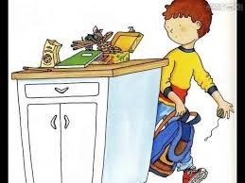
Characters
The boy and his friend the mouse

Slide 3
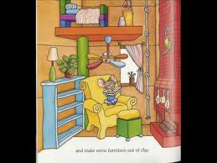
Setting
At school
Summer

Slide 4
plot beginning
The mouse will ask you for your lunchbox and he will want a sandwich.

Slide 5
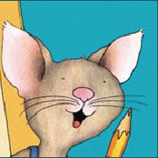
Plot middle
If the mouse is done with his lunch he will want to build a house.

Slide 6
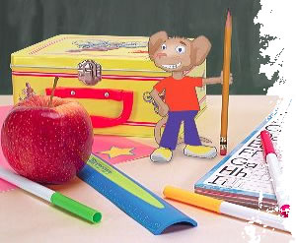
Plot end
Back to school.

Slide 7
Author’s message
In the book school is fun.

Slide 8
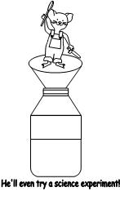
Favorite quote from book
When he does a science experiment. Page 9

