Slide 1
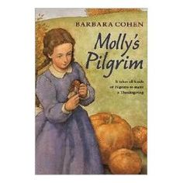
Molly’s Pilgrim Author : Barbara Cohen
By Nalee Mek

Slide 2
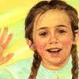
Characters
Molly, mom
Miss Stickly, Elizabeth
Fay, Emma

Slide 3
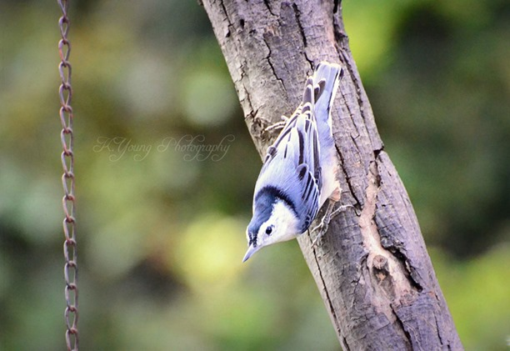
Setting
Winters Hill
school

Slide 4
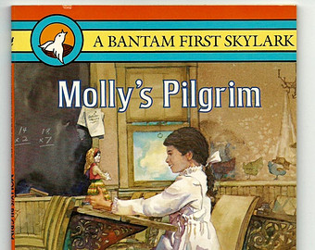
Plot (beginning)
There’s a girl named Molly. She didn’t like her school. Because the kid’s there laughed at her.

Slide 5
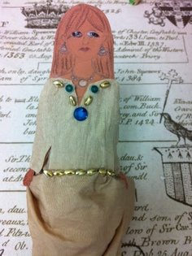
Plot (middle)
Her class had to make a pilgrim. And when she got home she told her mom . And her mom made her one.

Slide 6
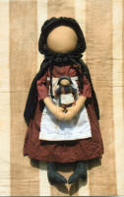
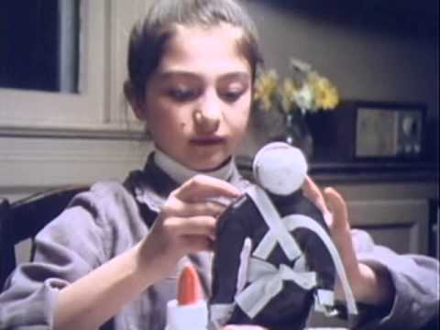
Plot (end)
She brought her doll to school and everyone liked it.

Slide 7
Author’s Message
. Don’t be a bully and be nice to others

Slide 8
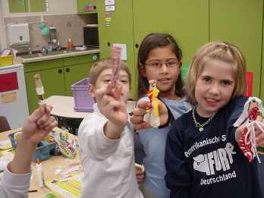
Favorite quote from the book
When everybody started being nice to Molly. On page 28.

