Slide 1
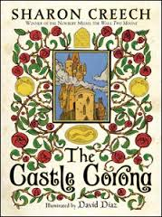
The Castle Corona Sharon Creech
Book Celebration
By Sara Belle Chapman

Slide 2
Characters
King, Queen
Prince, princess, spare prince
Hermit, master, old woman
Peasant Girl, Peasant Boy

Slide 3
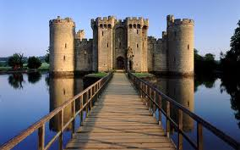
Setting
Castle, Village
During the Springtime
16th or 17th century

Slide 4
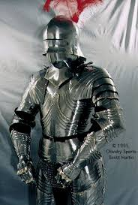
Plot Beginning
In the begging, knights from the palace came chasing after a thief. The peasant girl and boy found a pouch.

Slide 5
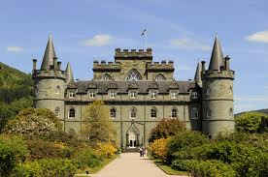
Plot Middle
The royal family gets a new hermit and new tasters.

Slide 6
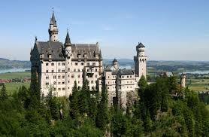
Plot End
The tasters and the royal family hear a story from the Wordsmith, and help make it up.

Slide 7
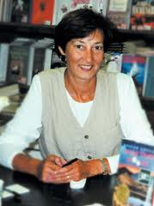
Author’s Message
Adventure lies before us.

Slide 8
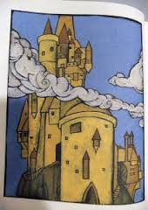
Favorite quote from the book
“Don’t ask me questions. It’s not permitted.
Follow me.”
on page 219

