Slide 1
Ninjas, Piranhas, and Galileo
Book Celebration
By Vonn
Author Greg Leitich Smith

Slide 2
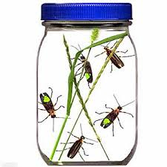
Characters
Elias, Shohei, and Honoria
Christoph
Tim

Slide 3
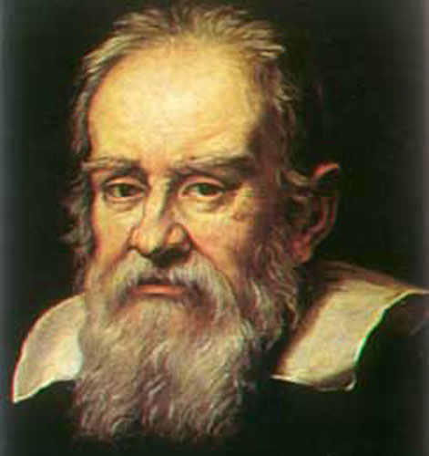
Setting
The setting is at school and their Homes
The story doesn’t tell me the time of Year.

Slide 4
Plot Beginning
Shohei is a normal boy who is Japanese and he gets adopted by parents who are Irish. His parents want him to feel at home. Elias is a boy who has a father who is a musician. Sometimes he gets very mad at her. Her name sounds like a boy’s name. At first I got confused. Honoria is a girl who has a mother who is a bug scientist. She has some piranhas for a pet. Kind of weird right?

Slide 5
Plot Middle
They find out that there is a science fair coming soon. They all get ready for the science fair by thinking of the projects they could do. Elias and Shohei work together on a science project together. Honoria does a project by herself. Elias’s and Shohei’s project is copying someone else’s project. Honoria’s project is to see if she can make a piranha eat a fruit rather than a piece of meat.

Slide 6
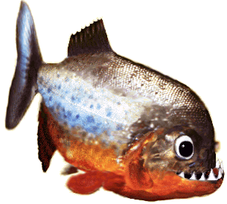
Plot End
At the end it Honoria and Shohei go to the court. They threaten to release grasshoppers in the school room if they don’t get a second chance.

Slide 7
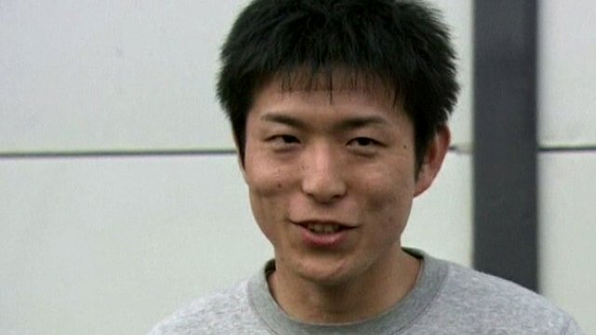
Author’s Message
Friends are always friends.

Slide 8
Favorite quote from the book
“Not quite,” dad said, “You are herby grounded for ten thousand years go to your room and do not come out.”
It is on page124

